Slide 1
Service Fabric Hackathon

Slide 2
Outline
Introductions
Overview | Walkthrough of the goals
Installations | VS.NET, Powershell, Service fabric SDK
Service Fabric | Create local SF agent app in vs.net Create local cluster Run locally
Deploy | Deploy app to azure with portal
CI | Create TS project Add code to TS Configure automatic build
Azure config – build with portal | Resource groups Key vault AD
CD | Create deploy task Update and auto deploy
Automate | Create cluster with PS / ARM

Slide 3
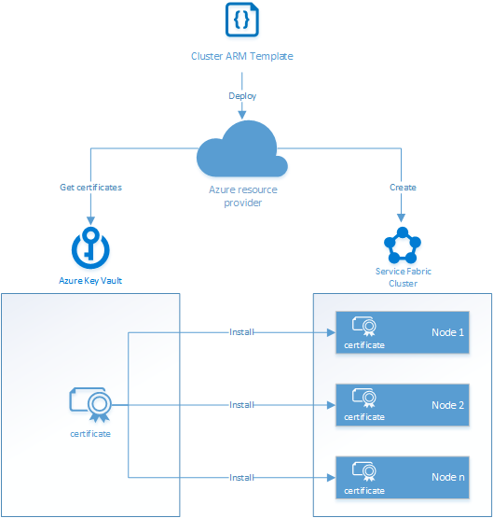

Slide 4
References
 | https://docs.microsoft.com/en-us/azure/service-fabric/service-fabric-cluster-creation-for-windows-server
Setup CI | https://docs.microsoft.com/en-us/azure/service-fabric/service-fabric-set-up-continuous-integration
Create via ARM | https://docs.microsoft.com/en-us/azure/service-fabric/service-fabric-cluster-creation-via-arm
Secure 5 Node ARM | https://github.com/Azure/azure-quickstart-templates/tree/master/service-fabric-secure-cluster-5-node-1-nodetype
Service Fabric in azure | https://opbuildstorageprod.blob.core.windows.net/output-pdf-files/en-us/Azure.azure-documents/live/service-fabric.pdf
Service Fabric SDK | http://www.microsoft.com/web/handlers/webpi.ashx?command=getinstallerredirect&appid=MicrosoftAzure-ServiceFabric-CoreSDK
Capacity Planning | https://docs.microsoft.com/en-us/azure/service-fabric/service-fabric-cluster-capacity
Deploy / manage local cluster | https://github.com/Microsoft/azure-docs/blob/master/articles/service-fabric/service-fabric-get-started-with-a-local-cluster.md
Create Service Fabric Cluster with Portal | https://github.com/Microsoft/azure-docs/blob/master/articles/service-fabric/service-fabric-cluster-creation-via-portal.md
Upgrades | https://github.com/Microsoft/azure-docs/blob/master/articles/service-fabric/service-fabric-application-upgrade.md

Slide 5
Useful Scripts / Extensions
SDK Cluster Setup | https://github.com/Microsoft/azure-docs/blob/master/articles/service-fabric/service-fabric-get-started-with-a-local-cluster.md
Dev Cluster Setup | & "$ENV:ProgramFiles\Microsoft SDKs\Service Fabric\ClusterSetup\DevClusterSetup.ps1" -CreateOneNodeCluster

Slide 6
Useful powershell commands
Connect-ServiceFabricCluster
Publish-NewServiceFabricApplication
Get-ServiceFabricApplication
Get-ServiceFabricService
Get-ServiceFabricPartition
Publish-UpgradedServiceFabricApplication
Unpublish-ServiceFabricApplication
Remove-ServiceFabricApplicationType

Slide 7
Deploy application

Slide 8
Upgrade Application
Publish-UpgradedServiceFabricApplication

Slide 9
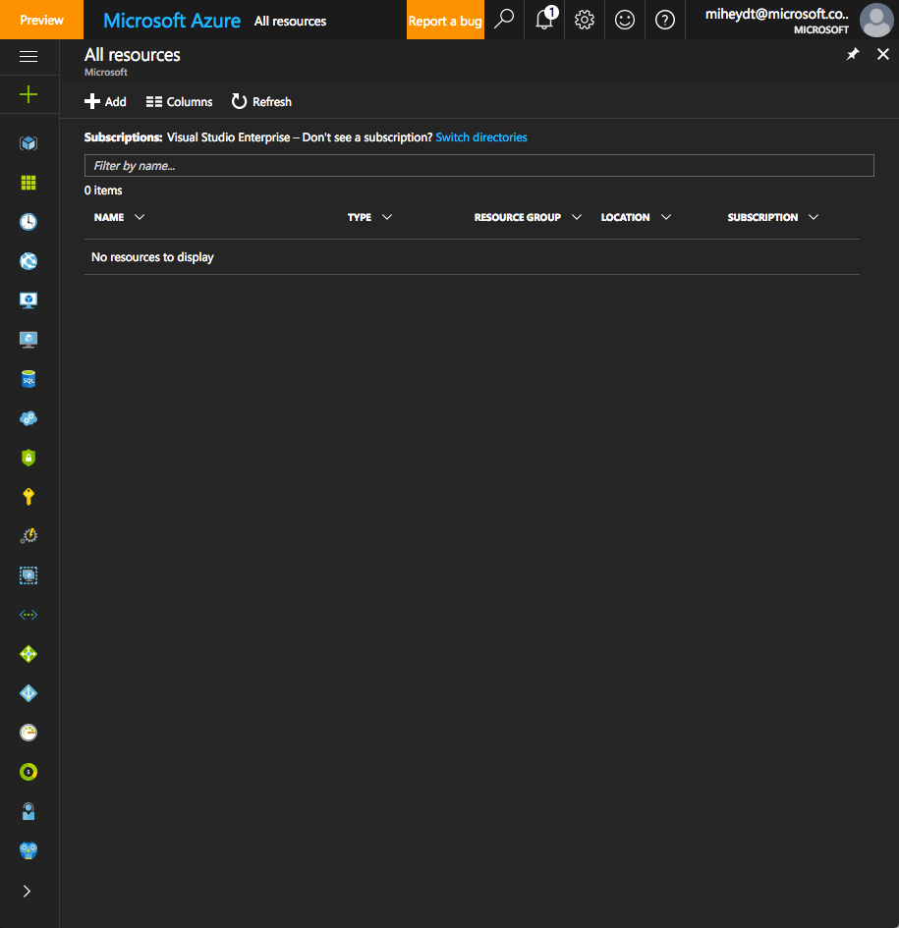

Slide 10
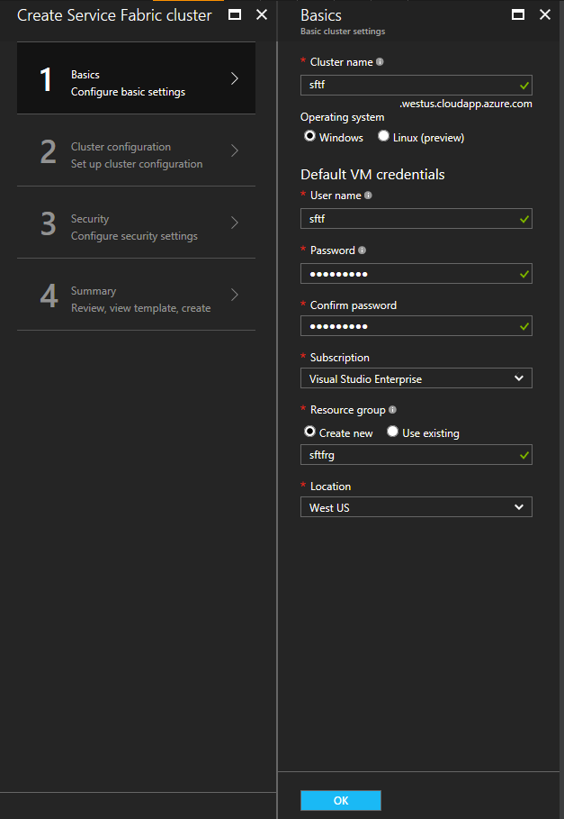

Slide 11
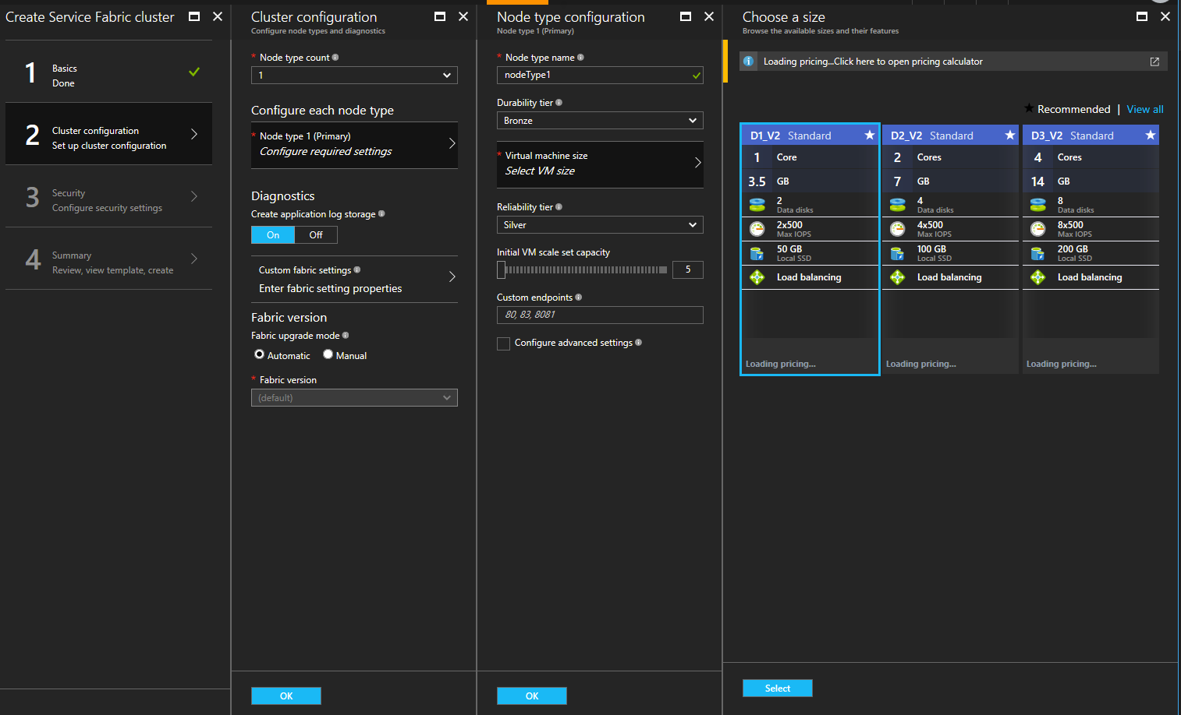

Slide 12
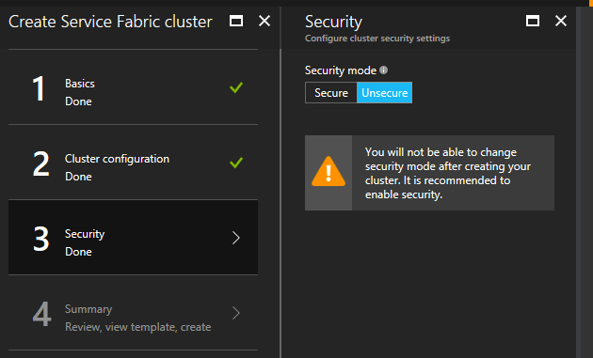

Slide 13
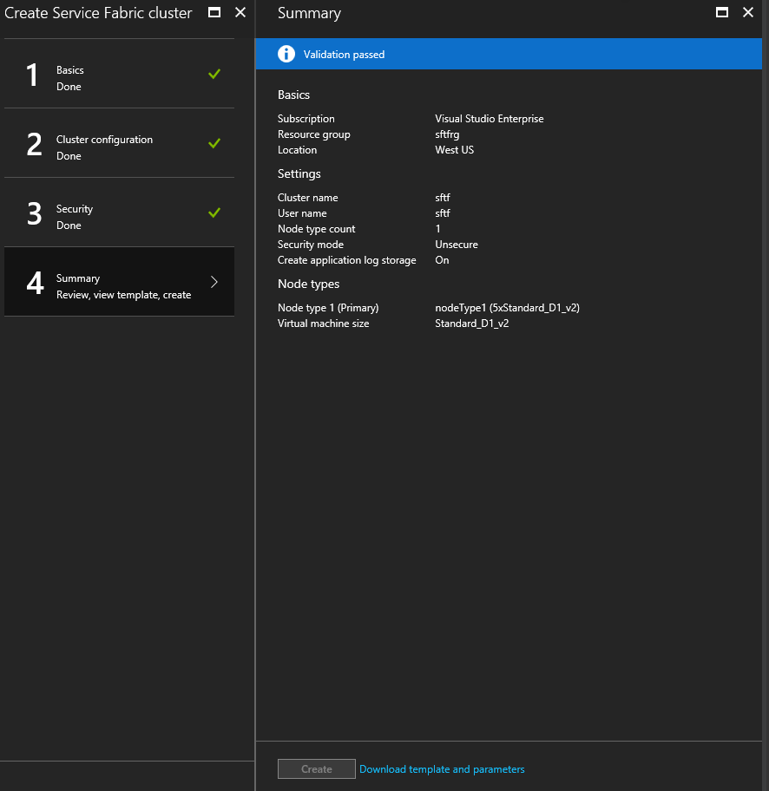

Slide 14
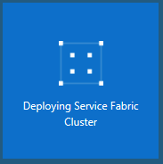

Slide 15
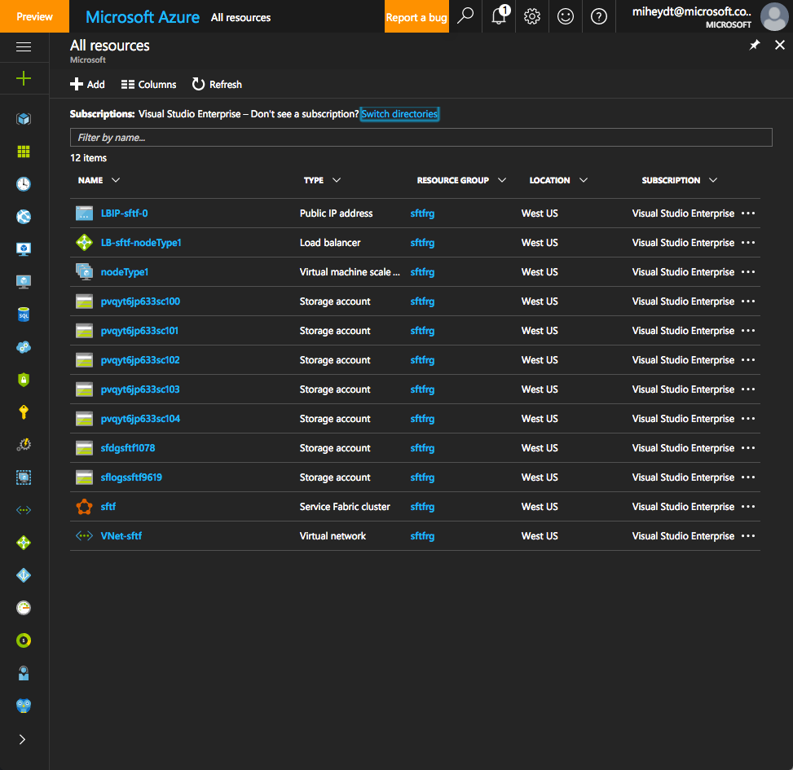

Slide 16
